Slide 1
Revision Cyclomatic Complexity, ECP, BVA, Architectural Design, Some UML diagrams

Slide 2
Verification
Definition: | The process of evaluating work-products (not the actual final product) of a development phase to determine whether they meet the specified requirements for that phase.
Objective: | To ensure that the product is being built according to the requirements and design specifications. In other words, to ensure that work products meet their specified requirements.
Question: | Are we building the product right?
Evaluation Items: | Plans, Requirement Specs, Design Specs, Code, Test Cases
Activities: | Static Testing (Reviews, Walkthroughs, Inspections)

Slide 3
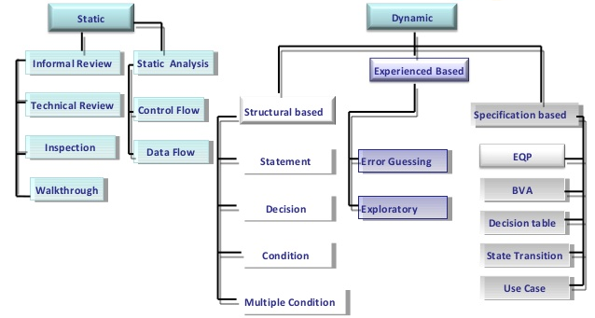
Test Design Techniques

Slide 4
Work Products that Can Be Examined by Static Testing
Specifications (SRS, FS, and Security Requirements etc)
User stories, and Acceptance criteria
Architecture and Design Specifications
Code
Testware (Test plans, Test Cases, Test Procedures, and Automated Test Scripts)
User guides
Web pages
Contracts, Project Plans, Schedules, and Budgets

Slide 5
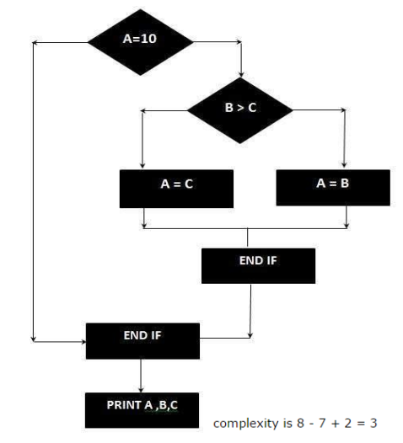
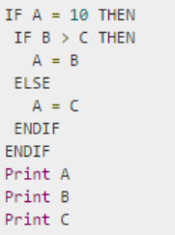
Static Analysis – CODE METRIC
Cyclomatic Code Complexity CC = E – N + 2P
E = Number of Edges N = Number of Nodes in Graph (Shapes) P = Exit Paths

Slide 6
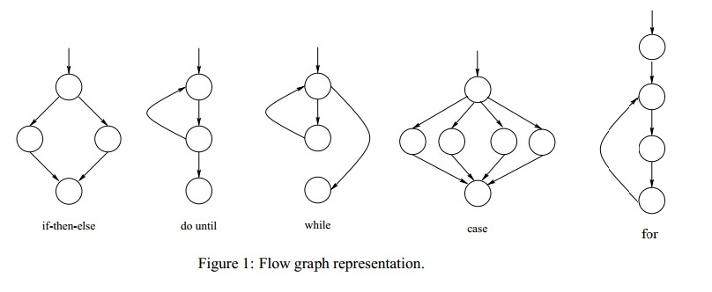
Cyclomatic Complexity

Slide 7
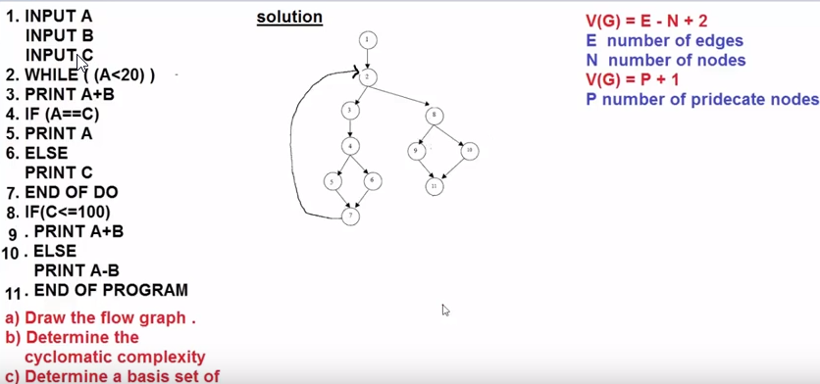
Cyclomatic Complexity
Path1: 1-2-8-9-11
Path2: 1-2-8-10-11
Path3: 1-2-3-4-5-7
Path4: 1-2-3-4-6-7

Slide 8
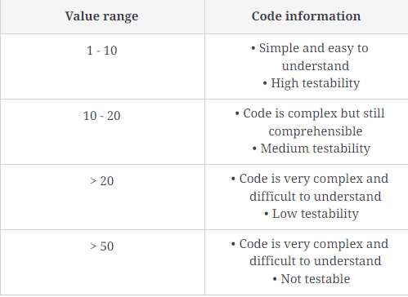
Cyclomatic Complexity Ranges

Slide 9
General Testing Principle
Testing shows the presence of defects, not their absence
Exhaustive testing is impossible
Early testing saves time and money
Defects cluster together
Beware of the pesticide paradox
Testing is context dependent
Absence-of-errors is a fallacy

Slide 10
Error/Failure Reasons
Errors may occur for many reasons, such as:
Time pressure.
Human fallibility.
Inexperienced or insufficiently skilled project participants.
Miscommunication between project participants.
Complexity of the code, design, architecture.
Misunderstandings about intra-system and inter-system interfaces, especially when such intra-system and inter-system interactions are large in numbers.
New, unfamiliar technologies.

Slide 11
Testing Objectives
To evaluate work products such as requirements, user stories, design, and code.
To verify whether all specified requirements have been fulfilled.
To validate whether the test object is completed and works as the users/stakeholders expect.
To build confidence in the level of quality of the test object.
To prevent defects.
To find failures and defects.
To reduce the level of risk of inadequate software quality (undetected failures in operation).
To comply with contractual, legal, or regulatory requirements or standards.
To provide sufficient information to stakeholders to allow them to make informed decisions, especially regarding the level of quality of the test object.

Slide 12
Test Levels, Type and Approaches
Unit Test
Integration Test
System Test
User Acceptance (UAT)
Functional Testing
Non-Functional Testing
Smoke Testing
Regression Testing
Re-Testing
Performance Testing
White-BOX Testing
Positive Testing
Automated Testing
Manual Testing
Security Testing
Sanity Testing
Alpha Testing
Beta Testing
Factor Acceptance Test (FAT)
Site Acceptance Test (SAT)
Usability Testing
Stress Testing
Load Testing
Compatibility Testing
Black-BOX Testing
Negative Testing
Static Testing
Dynamic Testing

Slide 13
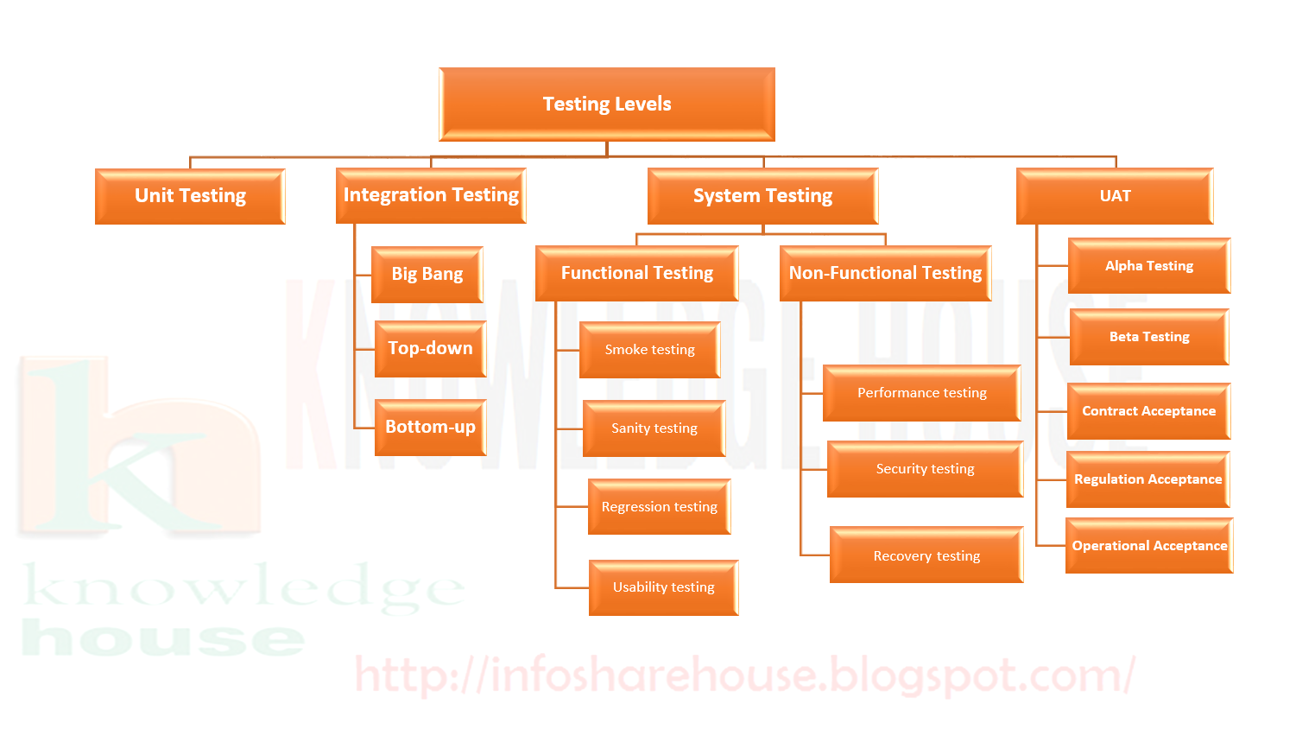
Test Levels, Type and Approaches

Slide 14
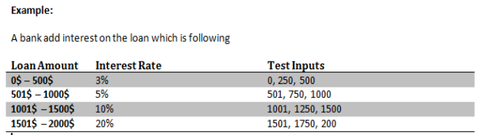
Specification Based – Black Box
Boundary Value
Equivalence Class Partitioning

Slide 15
Specification Based – Black Box
Order numbers on a stock control system can range between 10000 and 99999 inclusive. Which of the following inputs might be a result of designing tests for only valid equivalence classes and valid boundaries:
A. 1000, 5000, 99999 B. 9999, 50000, 100000 C. 10000, 50000, 99999 D. 10000, 99999 E. 9999, 10000, 50000, 99999, 10000

Slide 16
Specification Based – Black Box
In a system designed to work out the tax to be paid:
An employee has £4000 of salary tax free.
The next £1500 is taxed at 10%
The next £28000 is taxed at 22%
Any further amount is taxed at 40%
To the nearest whole pound, which of these is a valid Boundary Value Analysis test case?
a) £1500
b) £32001
c) £33501
d) £28000

Slide 17
Specification Based – Black Box
A thermometer measures temperature in whole degrees only. If the temperature falls below 18 degrees, the heating is switched off. It is switched on again when the temperature reaches 21 degrees. What are the best values in degrees to cover all equivalence partitions?
A. 15, 19 and 25. B. 17, 18 and19. C. 18, 20 and22. D. 16, 26 and 32.

Slide 18
Specification Based – Black Box
In a system designed to work out the tax to be paid:
An employee has £4000 of salary tax free.
The next £1500 is taxed at 10%
The next £28000 is taxed at 22%
Any further amount is taxed at 40%
Which of these groups of numbers would fall into the same equivalence class?
a) £4800; £14000; £28000
b) £5200; £5500; £28000
c) £28001; £32000; £35000
d) £5800; £28000; £32000

Slide 19
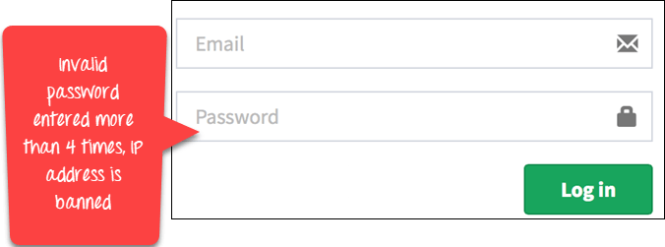
Specification Based – Black Box
Main Success Scenario | Step | Description
A:Actor S:System | 1 | A: Enter Agent Name & Password
 | 2 | S: Validate Password
 | 3 | S: Allow Account Access
Extensions | 2a | Password not valid S: Display Message and ask for re-try 4 times
 | 2b | Password not valid 4 times S: Close Application
Use Case Testing
In a use-case, an actor is represented by "A" and system by "S". We create Use for a login functionality of a Web Application as shown:
Consider the first step of an end to end scenario for a login functionality for web application where the Actor enters email and password.
In the next step, the system will validate the password
Next, if the password is correct, the access will be granted
There can be an extension of this use case. In case password is not valid system will display a message and ask for re-try four times
If Password, not valid four times system will ban the IP address.
Main Scenario | Step | Description
A:Actor S:System | 1 | A: Enter Agent Name & Password
 | 2 | S: Validate Password
 | 3 | S: Allow Account Access
Extensions | 2a | Password not valid S: Display Message and ask for re-try 4 times
 | 2b | Password not valid 4 times S: Close Application

Slide 20
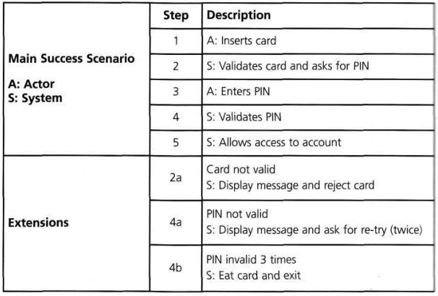
Specification Based – Black Box
Use Case Testing

